Slide 1
Business loans
By: Ashlyn Silks

Slide 2
Equipment Financing
Can finance up to 100% of new equipment
Has limited paperwork
Can finance all types and sizes of commercial businesses
Interest Rate- 4%
Total Ending Balance- $16,448.49
Ending Interest- $110.34

Slide 3
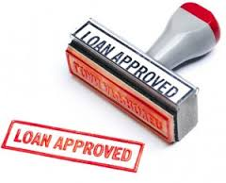
Short Term Loan
Instead of requiring monthly payments, the payment is due at the end of an agreed-upon term
Often used for shorter term needs, like to build up an inventory or complete small projects under $100,000
Good for if you want to grow your business
Interest Rate- 2%
Total Ending Balance- $2,544.72
Ending Interest- $4.58

Slide 4
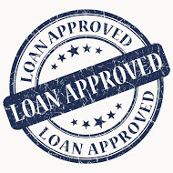
Conventional Loan
Typically offer flexible terms and pricing for hair salons
Lending institutions are able to give even lower pricing based on the strength of the loan request
Arranged through traditional banks and even some non-banking lenders
Interest Rate- 10%
Total Ending Balance- $1,187.11
Ending Interest- $1.16

Slide 5
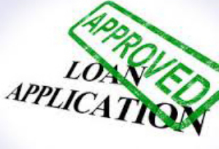
Why I Chose Conventional Loans
I chose the Convention Loan for my business because most salons use it, and it can be specifically for them, especially if they are a growing business.

