Slide 1
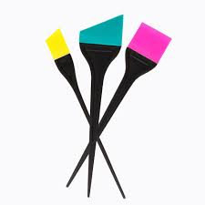
Color Outside the lines
By: Ashlyn Silks

Slide 2
Location
The location of my salon is 8591 Santa Monica Boulevard, West Hollywood, California 90069

Slide 3
Employees
There will be 10 employees, including me, that will be working here
All employees must have a cosmetology license

Slide 4
Salon Days and Hours
Open every day, except for Sundays, Mondays, and the holidays
Tuesday through Friday it is open from 10 AM to 4 PM, and on Saturdays it is open from 9 AM to 5 PM

Slide 5
Total Amount Needed
The total amount for just the hair color is $1,968.55
In order to start up my color salon, I will need a total of $24,080.57

Slide 6
How Much Employees Get
My employees will get paid according to how many people they worked on, and how much the cost was of what the client got done
Will be paid every 2 weeks, with a direct deposit

Slide 7
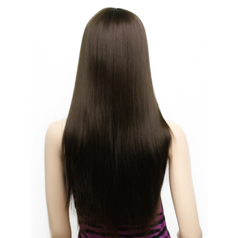
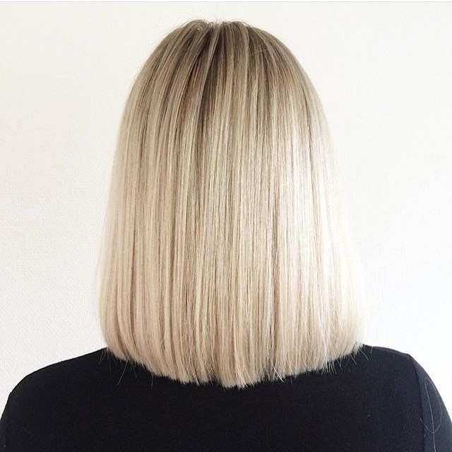
Cost of Services
More expensive
Costs will depend on if you want your hair bleached, how long your hair is, and how much of it you want colored
Less expensive
Longer hair will be more expensive for coloring, since there is more product being used
Longer and darker hair will be more expensive for bleaching, because for dark hair, you may have to bleach repeatedly

Slide 8
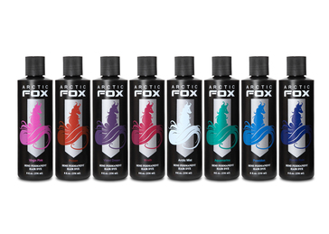
Estimated Costs
Permanent hair color: $83.00
Temporary hair color: $62.00
Bleaching: can be anywhere from $40 to $150

Slide 9
Conclusion
For this color salon to start up, the total amount of money I will need to buy everything, will be $24, 080.57.
My employees will be paid bi-weekly and according to their work. The salon will have every color in stock, and they will all be restocked every week, and it will cost around $1,968.55 for all of them to be bought.

